Slide 1
Group 3: Our plan for the final presentation
Logan Bingaman, Brianna Carbonara, Alex R Crovella, Joseph Huang, Nick Mater, Katie Mitchell, Eric Roos

Slide 2
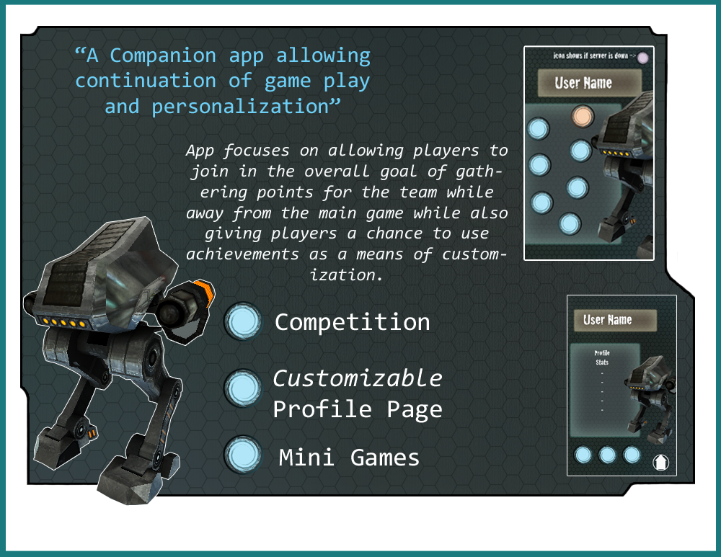
Notes:
The App’s potential is brought out the most when combined with multiplayer games. The type of multiplayer is not a huge concern as long as players are able to break off into teams and compete with each other in some manner.

Slide 3
LOGIN
HUMAN
MENU
ROBOT
MENU
PROFILE
PAGE
SETTINGS
REWARDS
ACHIEVEMENT
LIST
Blue
static
pages
Green
dynamic pages connects to server and website
HINTS
MAP
WIKI
COMPETITION
MINI GAMES

Slide 4
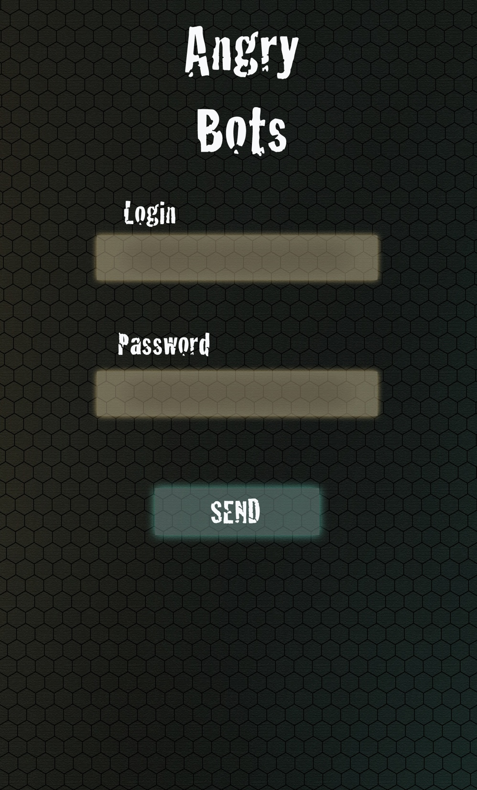
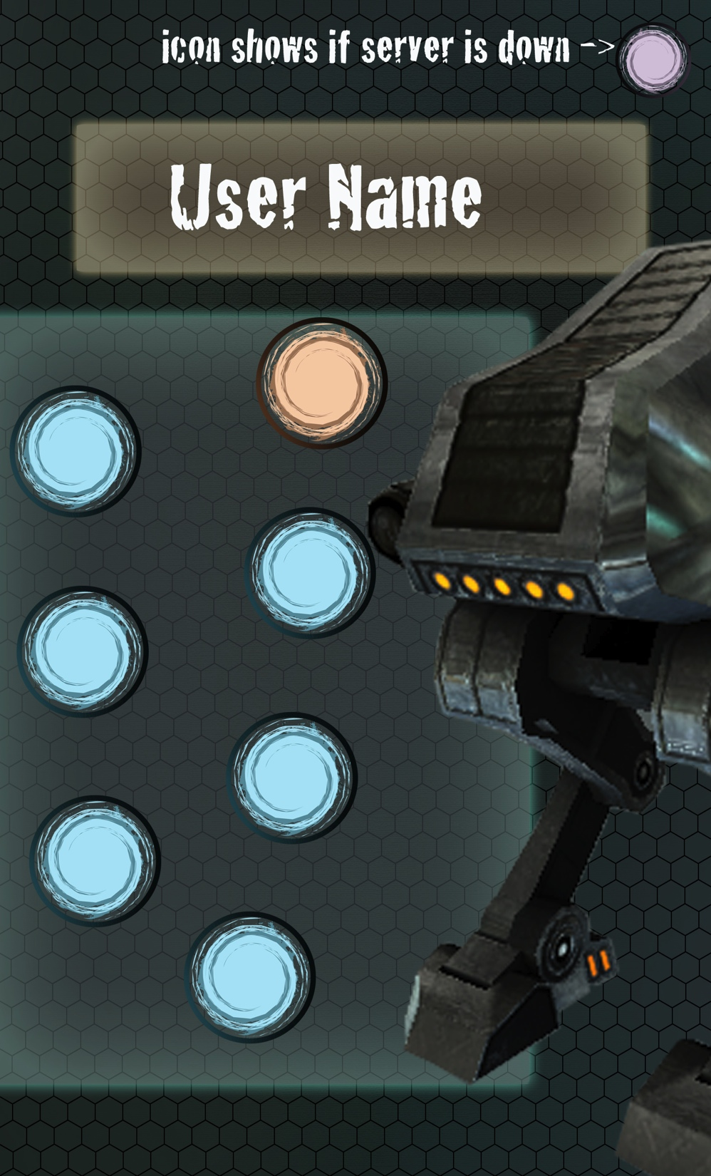

Slide 5
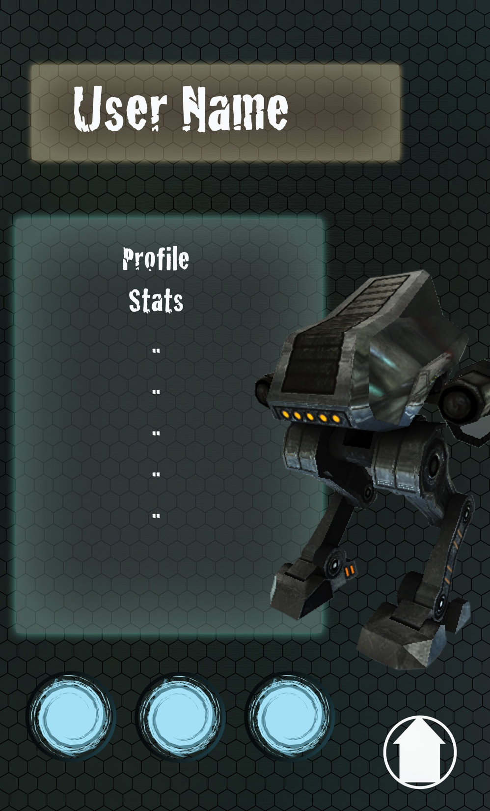
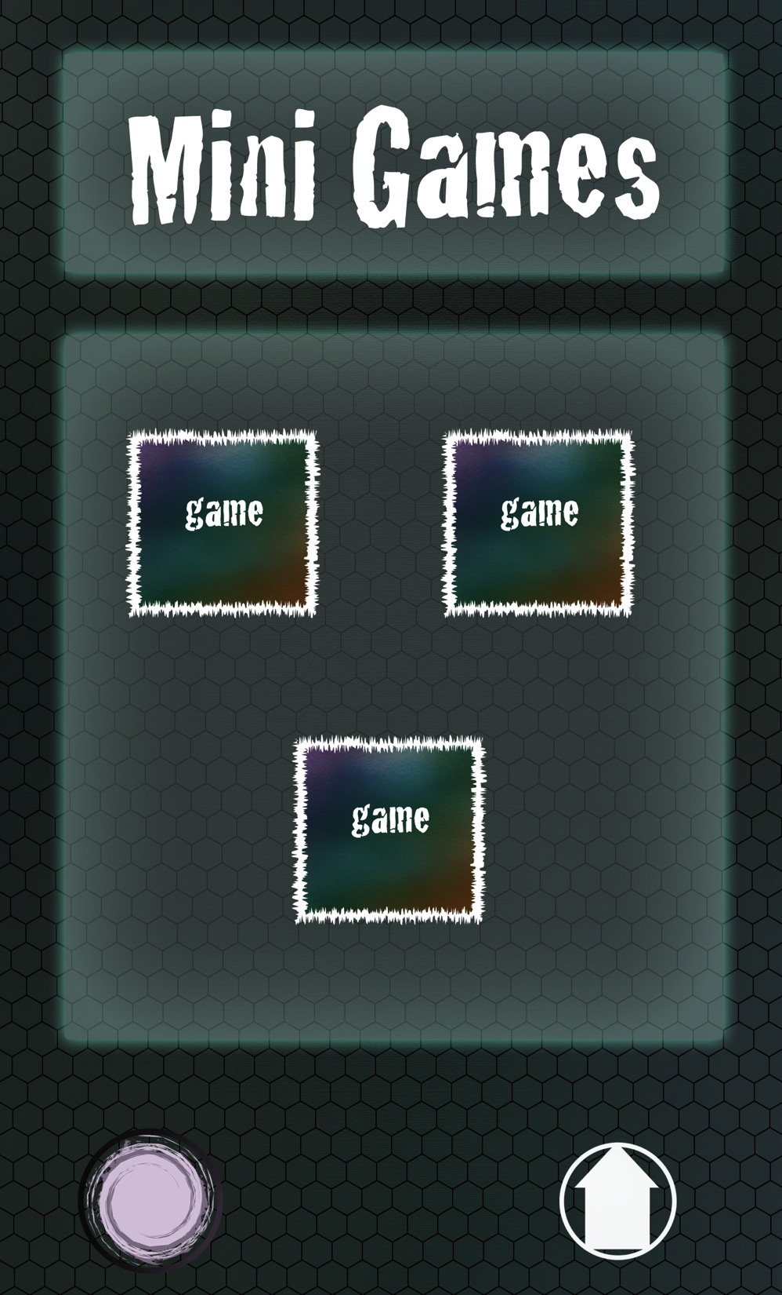

Slide 6
Final Presentation
Competition
Teams
Weekly Competition
Customizable Profile Page
Player’s Stats
Ranking
Mini Games
Simple Games
Cycle Games
Notes:
Competition
Split into team
Player Chooses
Gather points for team and themselves
Weekly Competition
Sub Missions
customizable profile page
Can Customize
By earning achievements
Shows player’s stats
Ranking
Mini games
Simple Games (demo 2-3)
Cycle Games

Slide 7
Final Presentation
Presenting Power Point to go along with:
App Demo
Demo of Gameplay in Unity

Slide 8
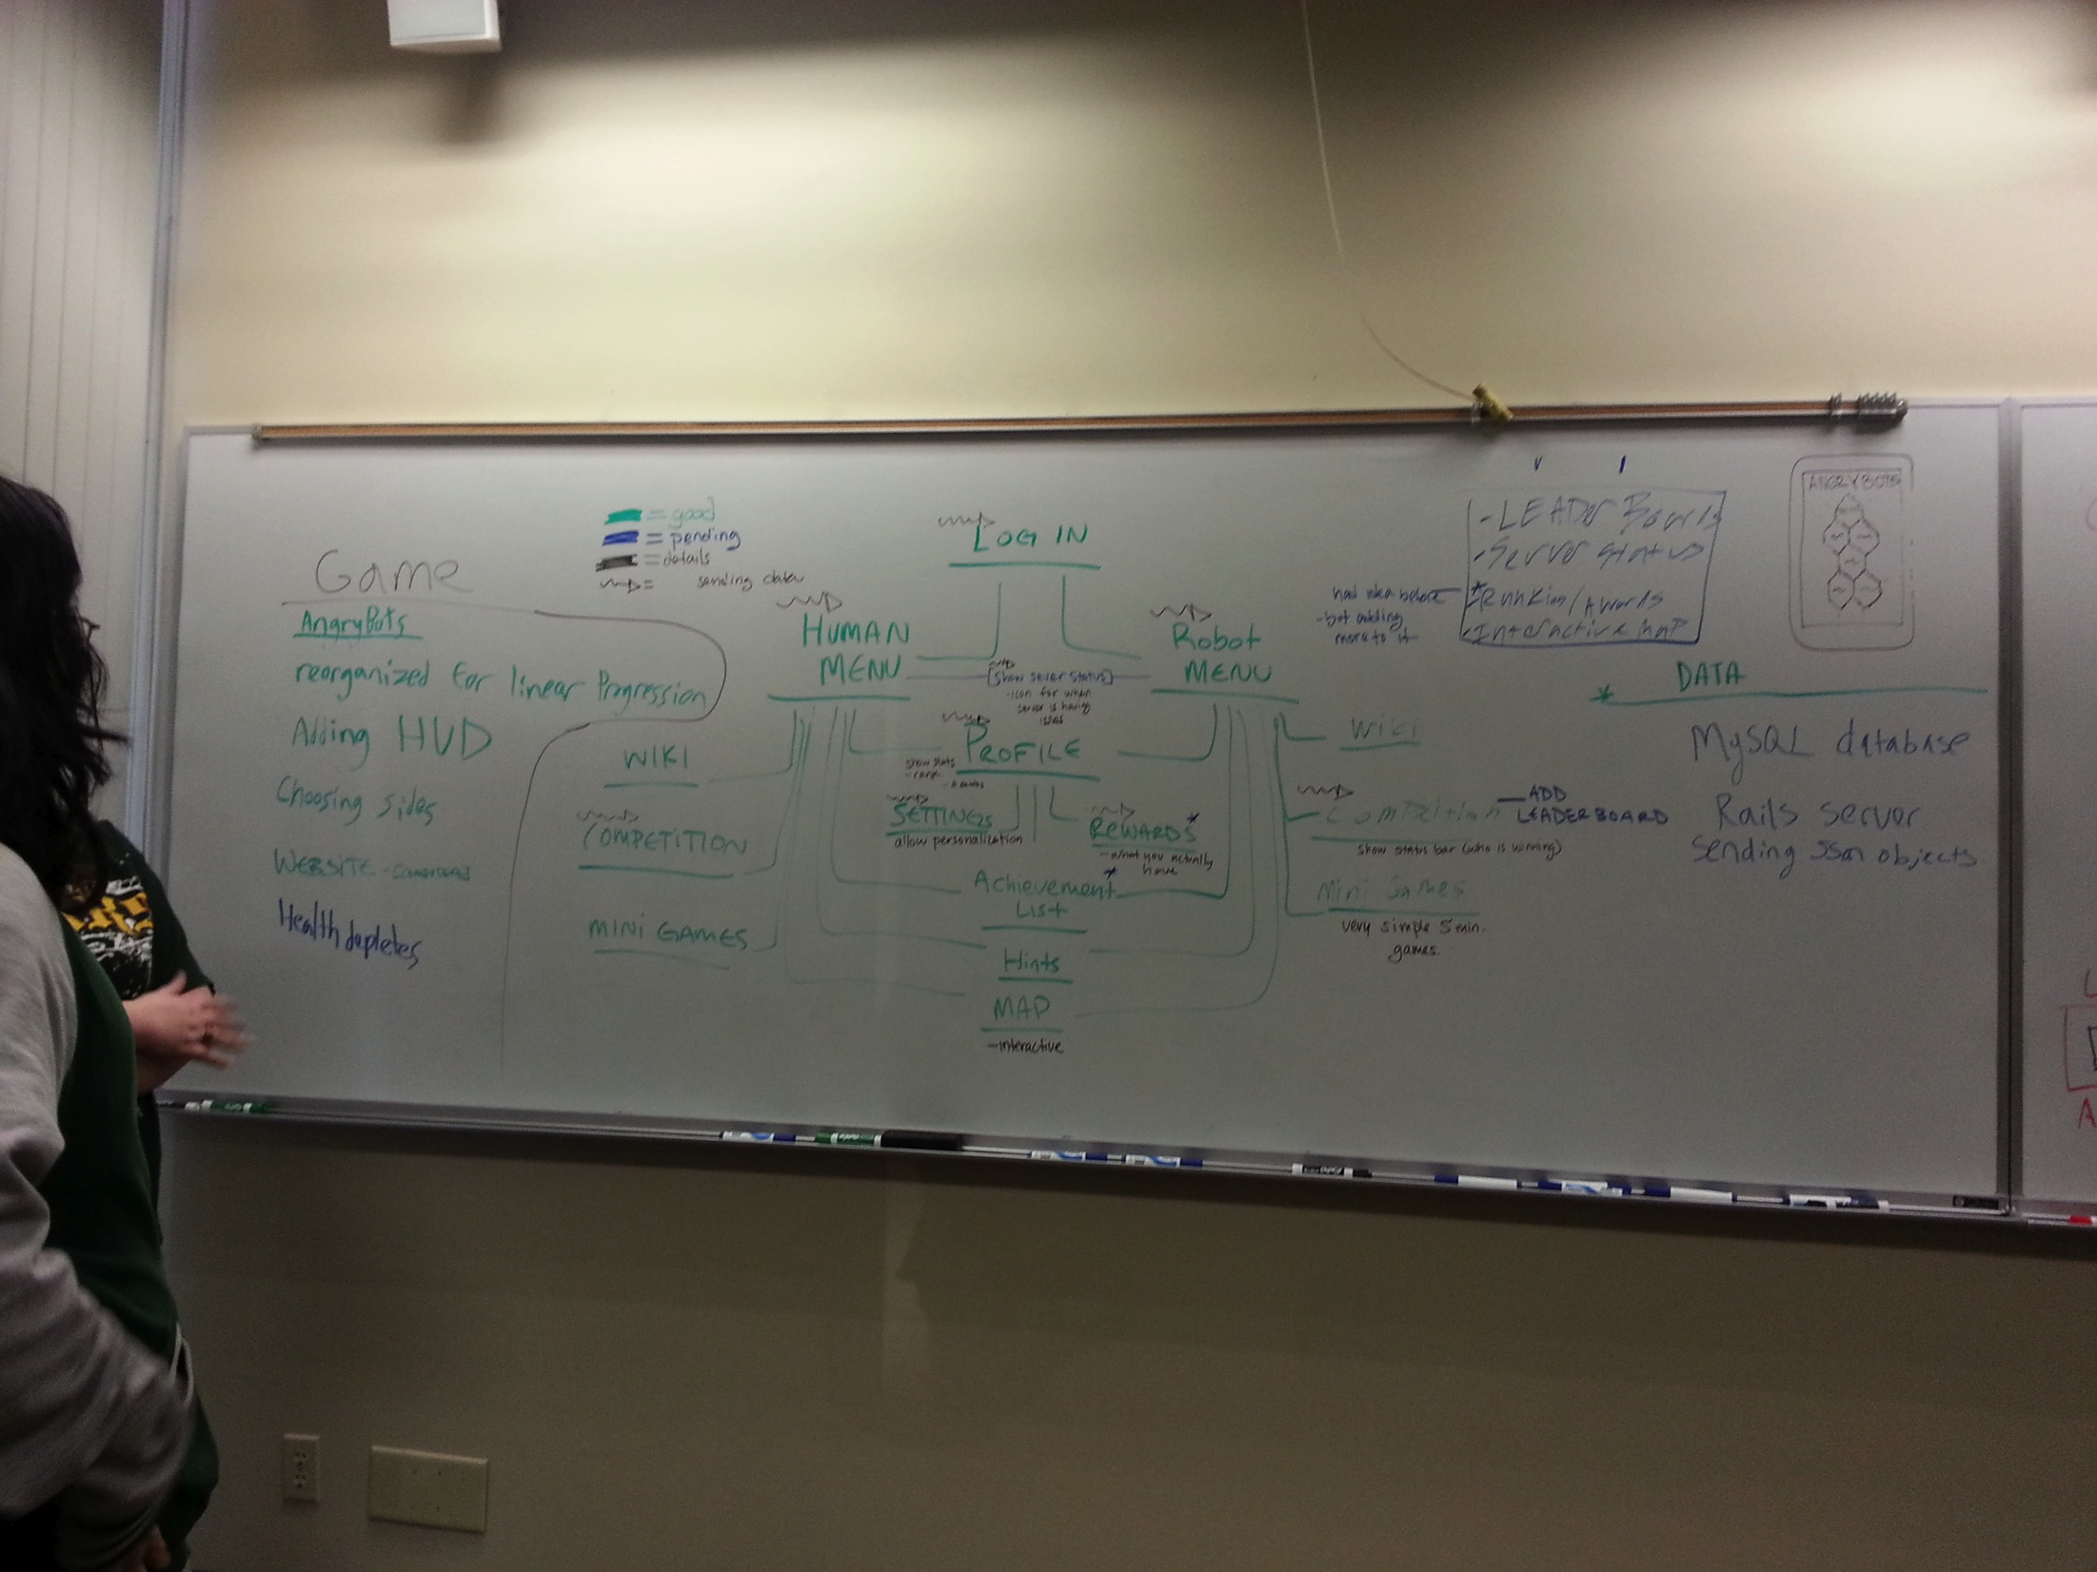

Slide 9
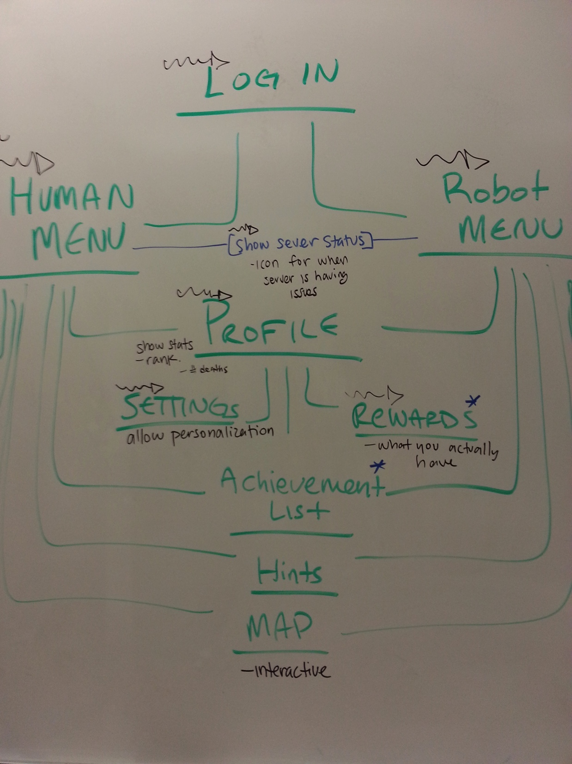

Slide 10
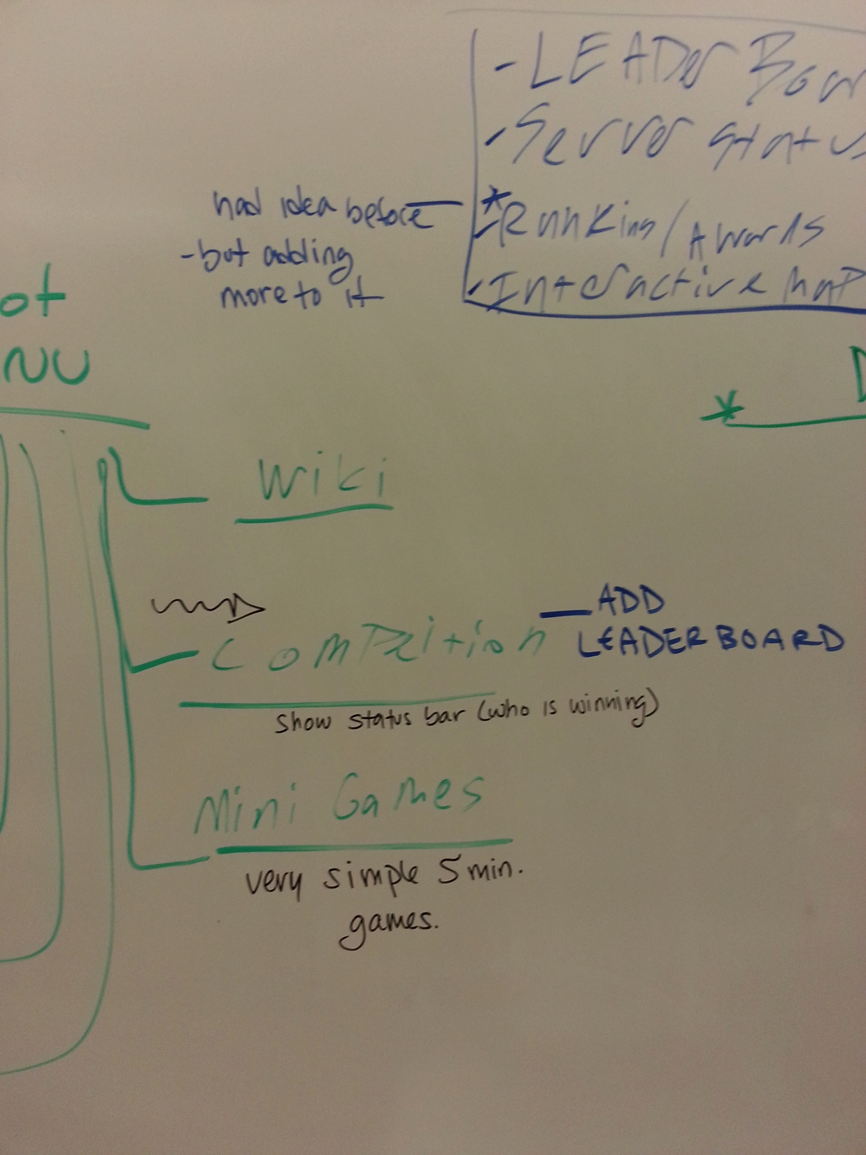

Slide 11
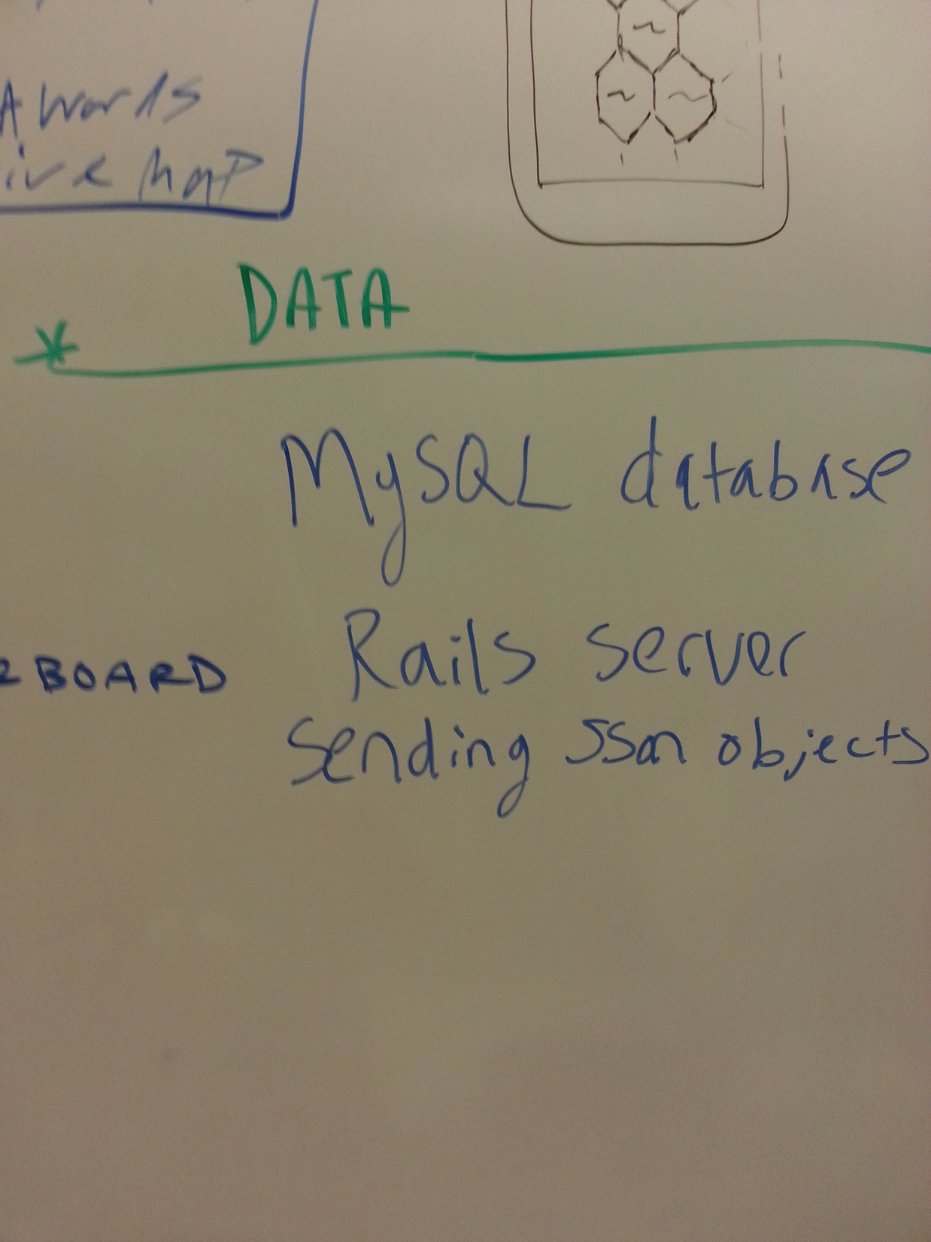

Slide 12
